Slide 1
COS 423: Theory of Algorithms
Kevin Wayne
Princeton University
Spring 2005

Slide 2
Administrative Stuff
Lectures. Kevin Wayne
  MW 10 - 10:50, Friend 109.
  Attendance is expected.
Precept. Amit Agarwal, Joshua Podolak
  Monday 8pm, room TBA.
  Preceptor works out problems.
Prereq. COS 226 and COS 341, or instructor's permission.
Textbook. Algorithm Design by Éva Tardos and Jon Kleinberg.
  Available at Triangle Copy, 150 Nassau Street.
Course web site. www.cs.princeton.edu/courses/archive/spring05/cos423
see me after class

Slide 3
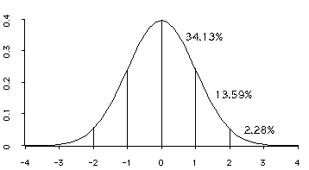
Grades
Grading.
  "Weekly" problem sets, due Wednesday 11am in class.
  Class participation, staff discretion for borderline cases.
  No exams.
  See handout on writing solutions.
Course grades.
  Undergrads: determined without considering grad students.
  Grads: determined using undergrad scale.
subject to change at instructor's whim
you are here

Slide 4
Collaboration
Collaboration policy. (see handout; ask if unsure)
  Course materials are always permitted.
  You are encouraged to attend office hours as needed.
  No external resources, e.g., Google, Tarjan.
"Collaboration permitted" problem sets.
  Can form study group of up to 3 students.
  Study group must work on each problem jointly.
  You must write up solutions individually.
"No collaboration" problem sets.
  Can always consult course staff.

Slide 5
Algorithms
Algorithm.
  [webster.com] A procedure for solving a mathematical problem (as of finding the greatest common divisor) in a finite number of steps that frequently involves repetition of an operation.
  [Knuth, TAOCP] An algorithm is a finite, definite, effective procedure, with some input and some output.
Great algorithms are the poetry of computation. Just like verse, they can be terse, allusive, dense, and even mysterious. But once unlocked, they cast a brilliant new light on some aspect of computing. - Francis Sullivan
Notes:
http://portal.newman.wa.edu.au/technology/12infsys/html/KWH2003/KnuthAlgorDef.htm
"Finite: there must be an end to it within a reasonable time.
Definite: precisely definable in clearly understood terms, no pinch of salt type vagaries, or possible ambiguities
Effective: the steps must be actually be able to be carried out. [simple enough for someone using pencil and paper to carry out in a finite amount of time]
Procedure: the sequence of specific steps arranged in a logical order.
Output: unless there is something coming out of the process, the result will remain unknown! "

Slide 6
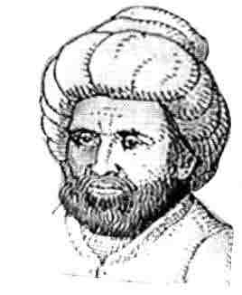
Etymology
Etymology. [Knuth, TAOCP]
  Algorism = process of doing arithmetic using Arabic numerals.
  A misperception: algiros [painful] + arithmos [number].
  True origin: Abu 'Abd Allah Muhammad ibn Musa al-Khwarizm was a famous 9th century Persian textbook author who wrote Kitab al-jabr wa'l-muqabala, which evolved into today's high school algebra text.
Notes:
revolutionized western mathematics: introduced decimal system, adopted use of 0, formal method for solving quadratic equations by completing the square, doing geometry
His book al-jabr evolved into today's high school algebra text.

Slide 7
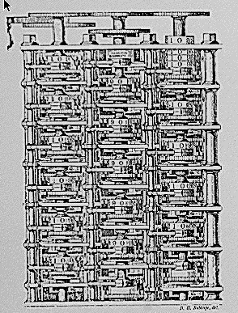
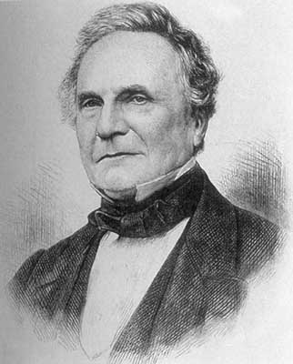
Theory of Algorithms
"As soon as an Analytic Engine exists, it will necessarily guide the future course of the science. Whenever any result is sought by its aid, the question will arise - By what course of calculation can these results be arrived at by the machine in the shortest time? - Charles Babbage
Notes:
His 19th century machine would have been first (mechanical) computer had he only succeeded in building it. His strikingly modern thought is nowadays more valid than ever, because the faster your computing equipment, the more you stand to gain from efficient algorithms. (Brassard + Bratley, p. xv)
A strikingly modern thought.

Slide 8
Algorithmic Paradigms
Design and analysis of computer algorithms.
  Greed.
  Divide-and-conquer.
  Dynamic programming.
  Network flow.
  Randomized algorithms.
  Intractability.
  Coping with intractability.
Critical thinking and problem-solving.
Notes:
* broad algorithmic themes and design principles
* paradigmatic problems and approaches that illustrate, with minimal amount of irrelevant detail, basic approaches in designing efficient algorithms. At the same time, it would be pointless to pursue design principles in a vacuum - we consider problems drawn from fundamental issues that arise throughout cs and elsewhere
* we also address fundamental barriers that prevent design of efficient algorithms

Slide 9
Applications
Wide range of applications.
  Caching.
  Compilers.
  Databases.
  Scheduling.
  Networking.
  Data analysis.
  Signal processing.
  Computer graphics.
  Scientific computing.
  Operations research.
  Artificial intelligence.
  Computational biology.
  . . .
We focus on algorithms and techniques that are useful in practice.

